Slide 1

EPL421 Systems Programming
Christophoros Efstathiou
Sotiris kasinidis

Slide 2
What is flutter ?
Flutter is a free and open-source mobile UI framework created by Google and released in May 2017. In a few words, it allows you to create a native mobile application with only one codebase. This means that you can use one programming language and one codebase to create two different apps (for iOS and Android).
Flutter consists of two important parts:
An SDK (Software Development Kit): A collection of tools that are going to help you develop your applications. This includes tools to compile your code into native machine code (code for iOS and Android).
A Framework (UI Library based on widgets): A collection of reusable UI elements (buttons, text inputs, sliders, and so on) that you can personalize for your own needs.

Slide 3

What is dart
Dart is a client-optimized language for developing fast apps on any platform. Its goal is to offer the most productive programming language for multi-platform development, paired with a flexible execution runtime platform for app frameworks

Slide 4
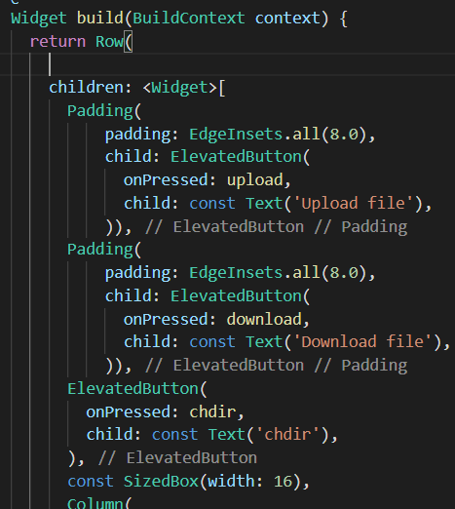
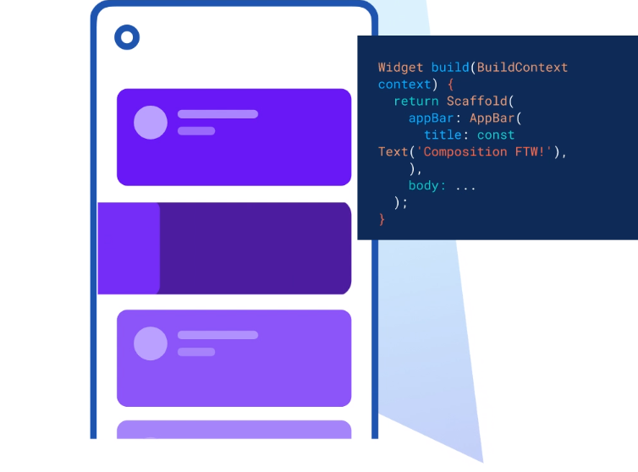
Flutter UI

Slide 5
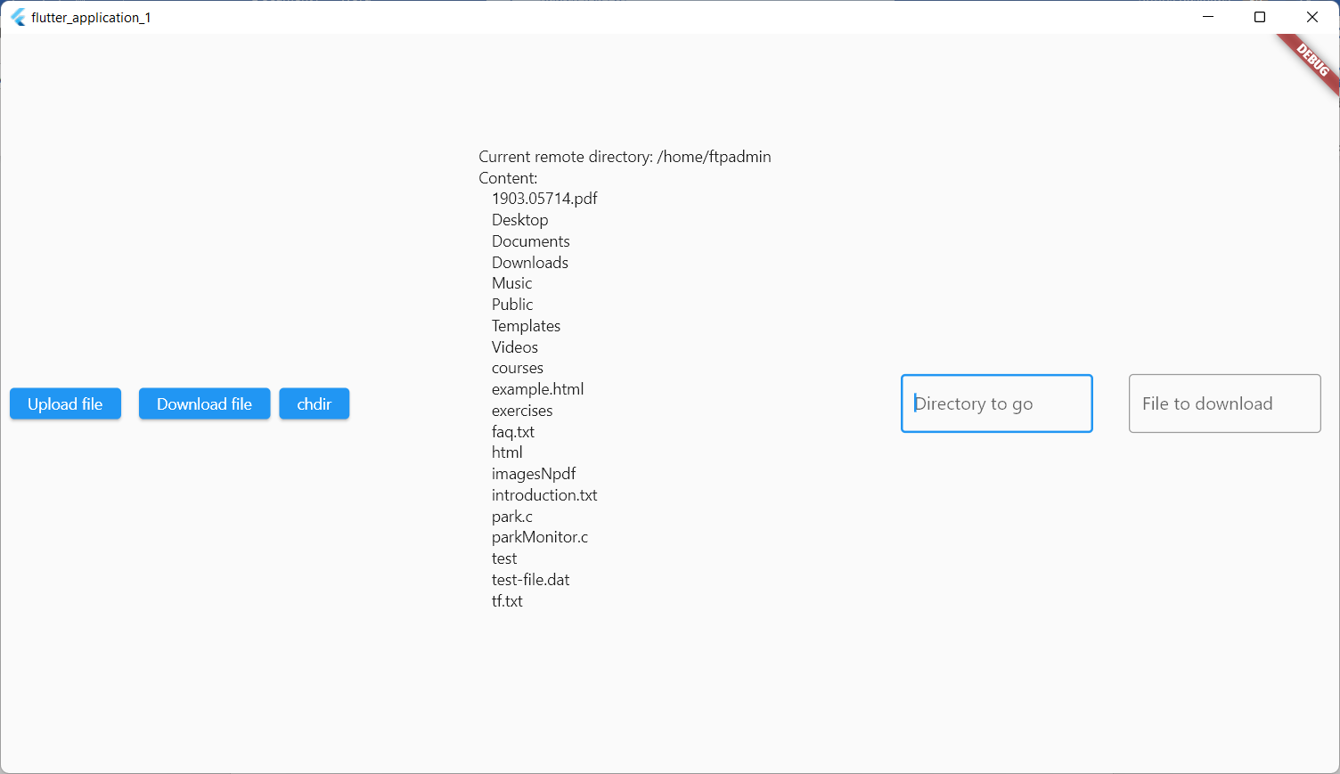
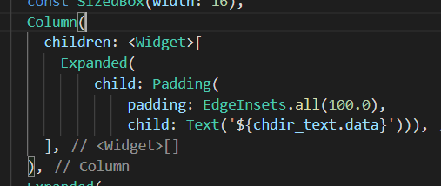
Flutter UI

Slide 6
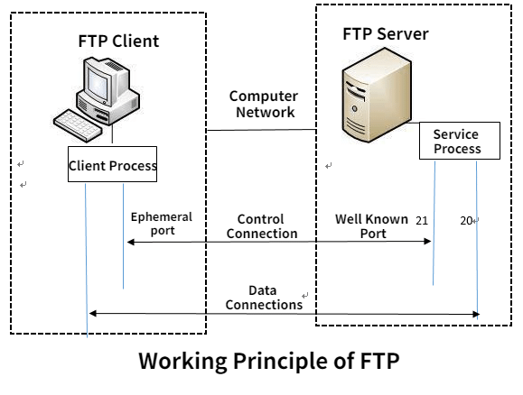
FTP
Flutter App VM server
The File Transfer Protocol is a standard communication protocol used for the transfer of computer files from a server to a client on a computer network. FTP is built on a client–server model architecture using separate control and data connections between the client and the server.
We use ftp to communicate with the server and to upload, download and change directory on the server

Slide 7

Dart library for FTP protocol
Dependencies
ftpconnect 1.0.1
Import
Key Features
Upload files to FTP
Download files/directories from FTP
List FTP directory contents
Manage FTP files (rename/delete)
Manage file zipping/unzipping
Completely asynchronous functions

Slide 8
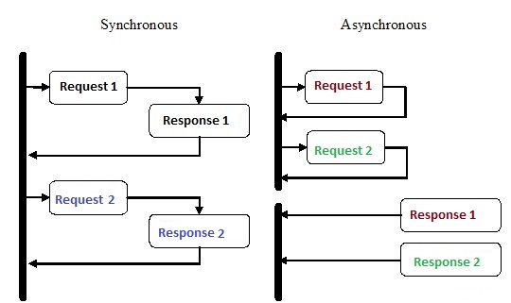
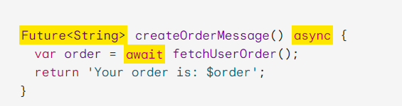
Asynchronous programming
Futures
A future represents the result of an asynchronous operation, and can have two states: uncompleted or completed.
async
You can use the async keyword before a function’s body to mark it as asynchronous.
await
You can use the await keyword to get the completed result of an asynchronous expression. The await keyword only works within an async function

Slide 9
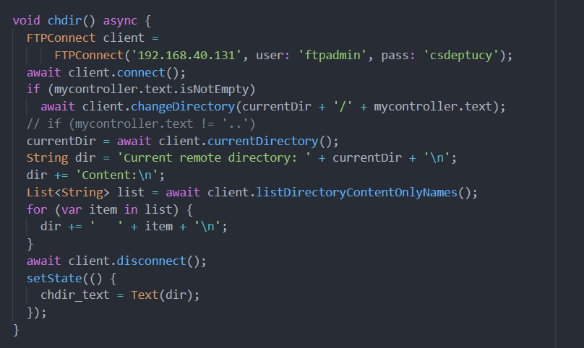
Change Directory
Change directory based on input
List the file names of current directory
Print each item in the text field

Slide 10
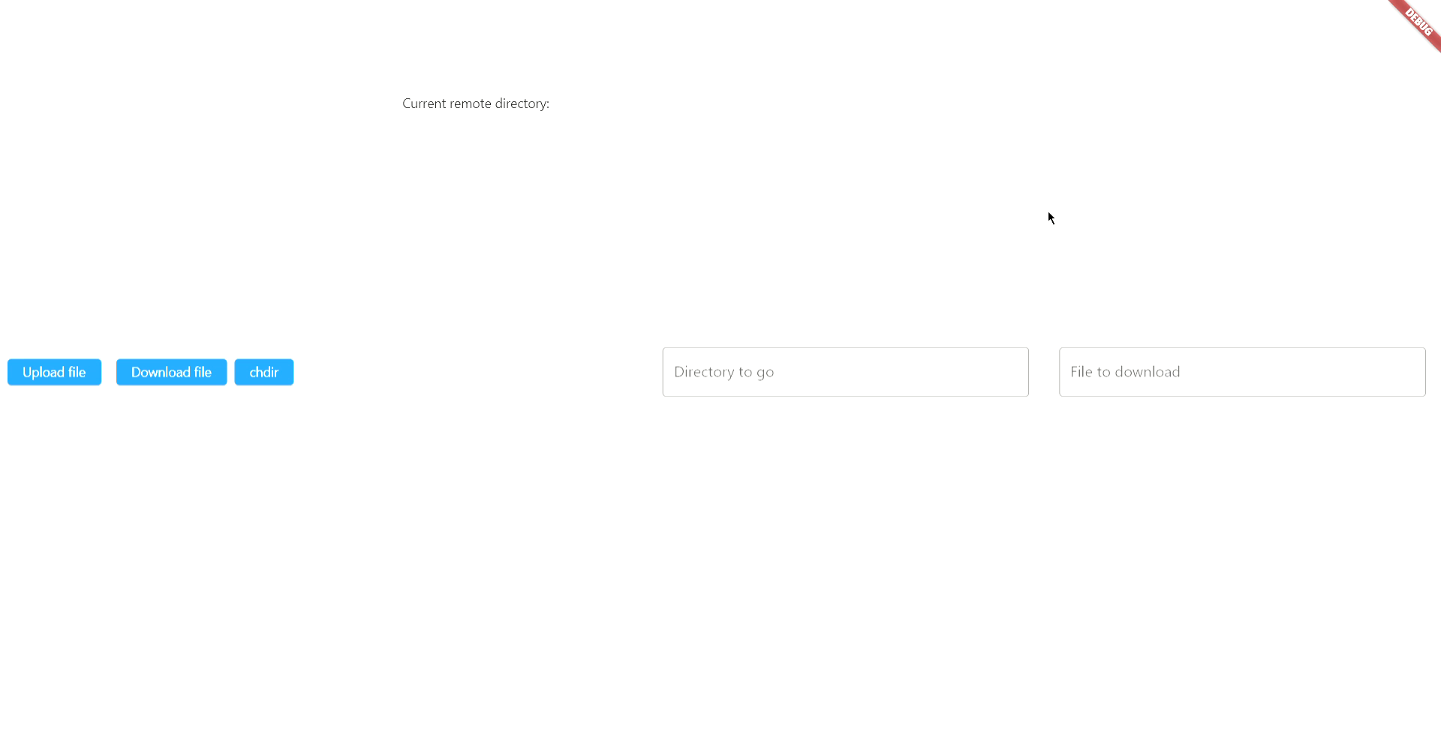
Change Directory Demo

Slide 11
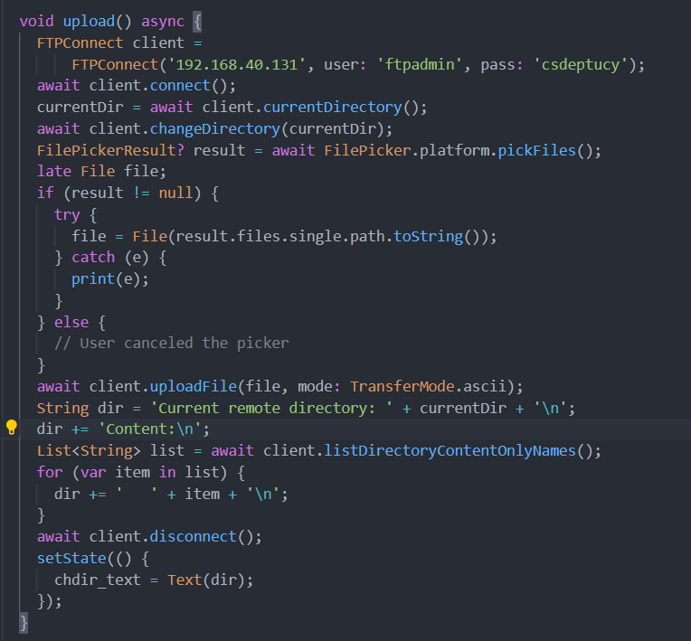
Upload file
Pick file with FilePicker (windows browse)
Upload file to server
Update the list of current directory

Slide 12
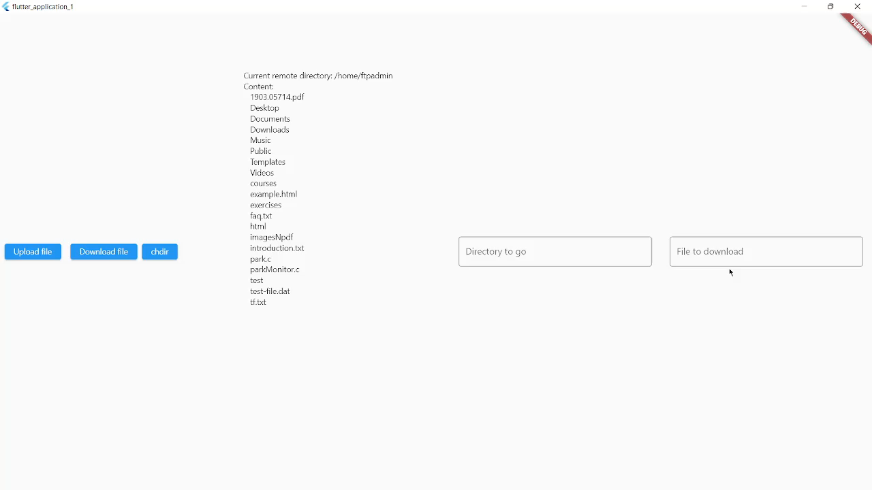
Upload file demo

Slide 13
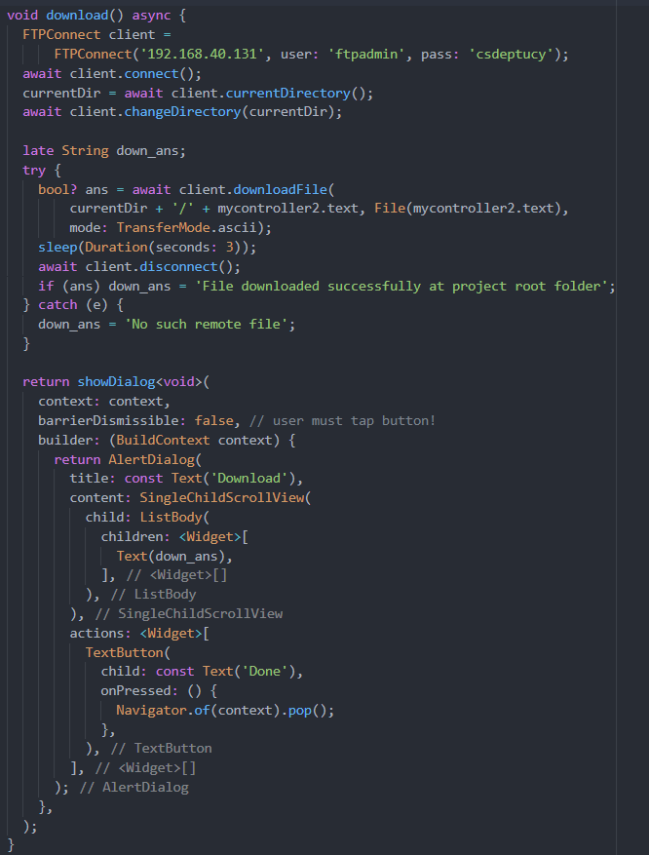
Download File
Checks if input file exists on server
Download file locally
Show the appropriate message on the screen

Slide 14
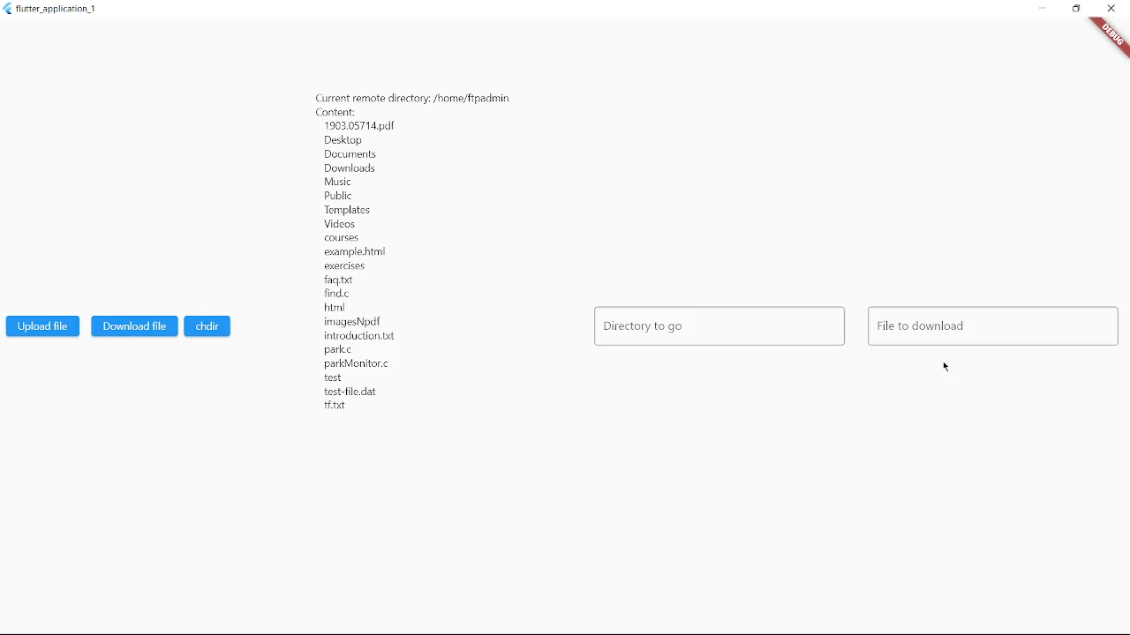
Download file demo

Slide 15

Flutter on Desktop
Implements on C++, and builds with CMake
Uses C header files and dll files
Runs on every machine

Slide 16

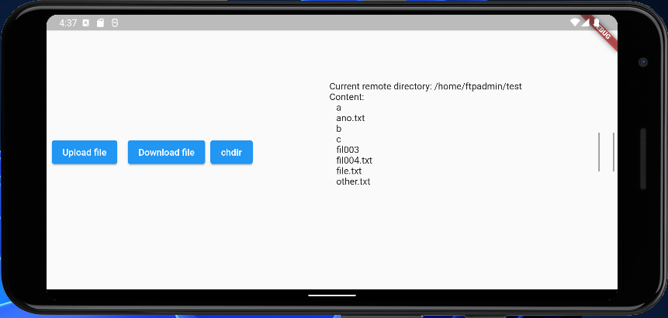
Flutter on Android
Runs on Android’s SDK
Compatible with all Android versions

Slide 17


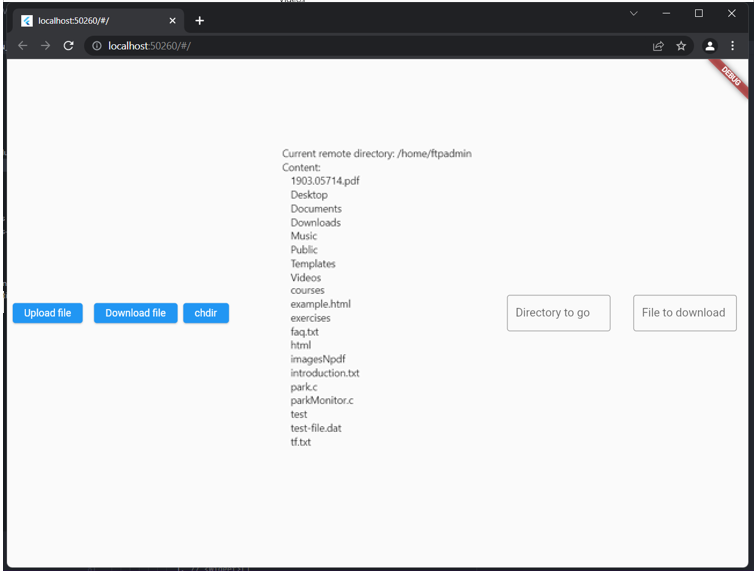
Flutter on web
Uses JavaScript and HTML code
Runs on both Google Chrome and Microsoft Edge

Slide 18
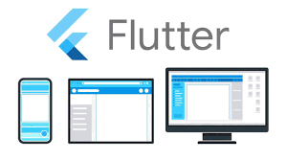
Thank you for your attention! Any questions?

